Slide 1
Azure Container Service
Chad Thomas
Neudesic
@chadcthomas

Slide 2
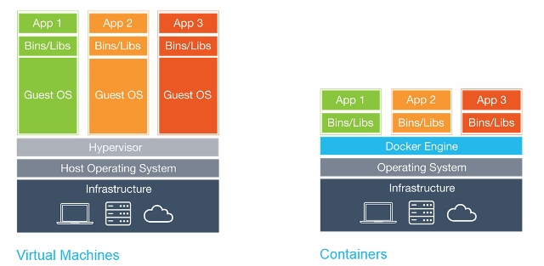
What is Docker and Containerization?

Slide 3
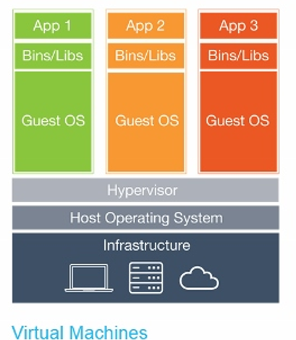
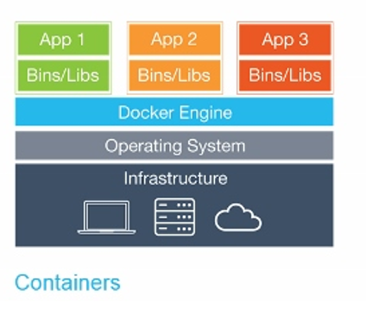
What is Docker and Containerization?
VIRTUAL MACHINE (VM)
Kernel Virtualization
requires a POST
Requires a huge binary file (image) to be portable
DOCKER CONTAINER
Shared Kernel
No POST
Requires a lightweight text file (Dockerfile) to be portable, plus layers of binary files (images)

Slide 4
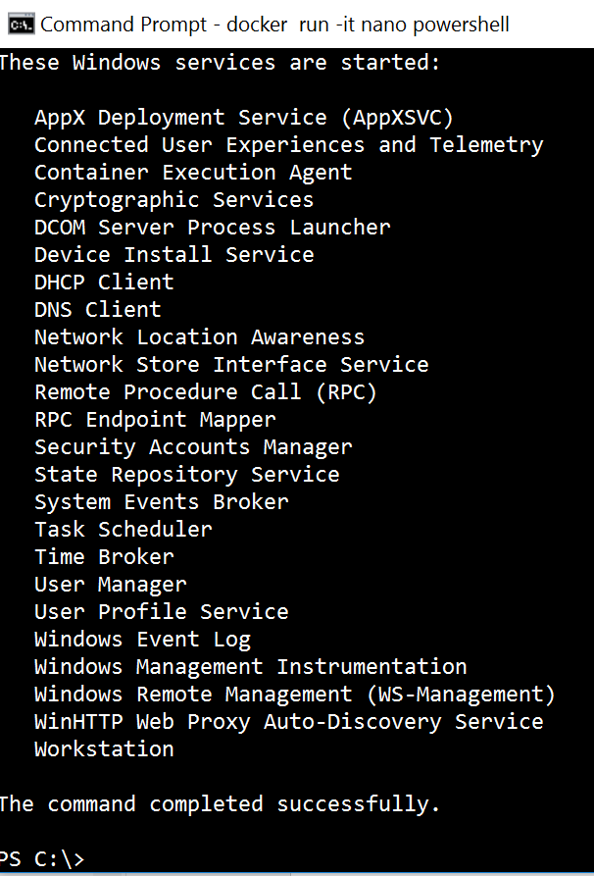
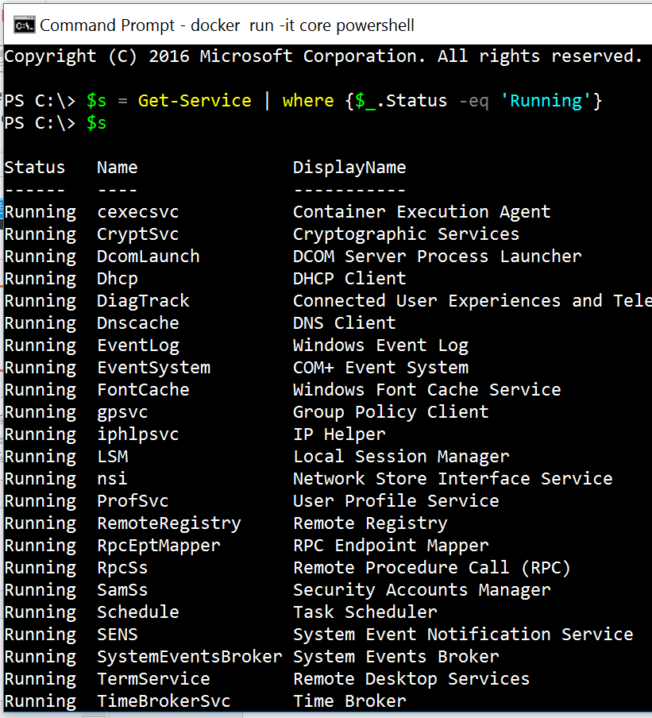
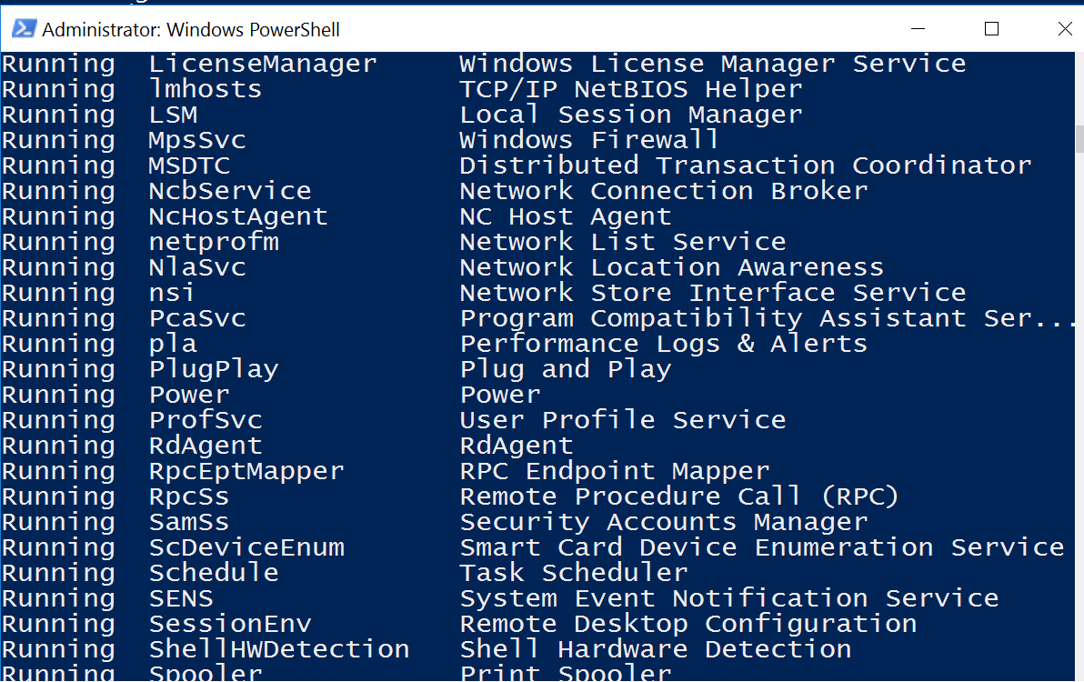
nano | core | server
24
28
77

Slide 5
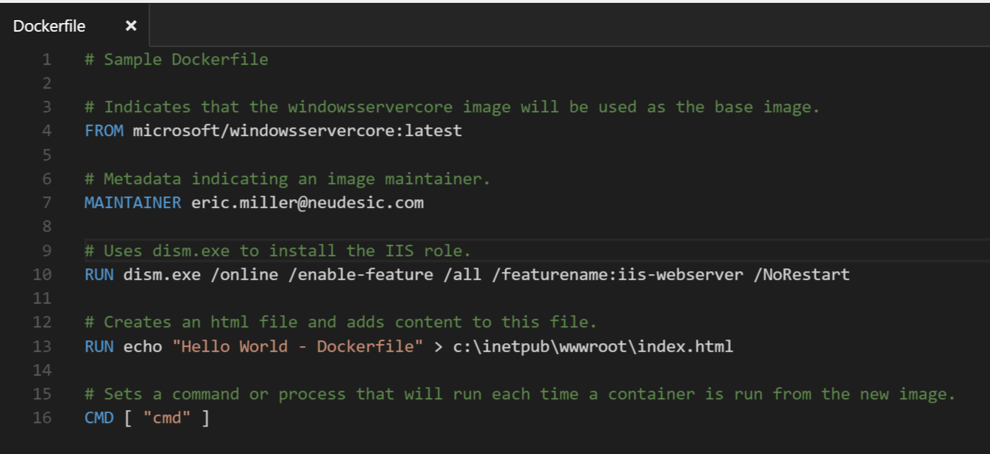
The Dockerfile

Slide 6
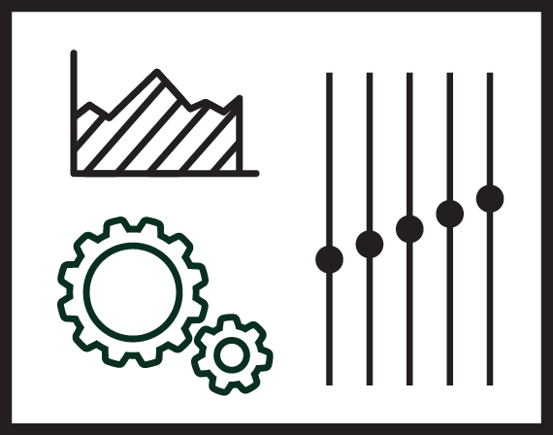

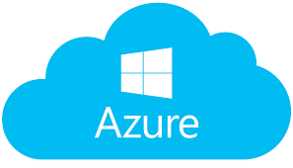
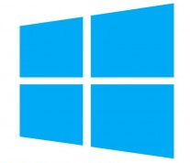

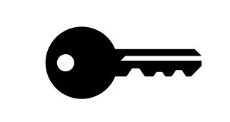

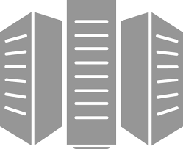
Docker Enterprise Manage Linux, Windows, x86
Developers
IT Operations
BUILD
Development Environments
SHIP
Secure Content & Collaboration
RUN
Deploy, Manage, Scale
Notes:
Docker: Manage Linux, Windows, x86
Same Docker engine on Linux and Win
Registry/DTR stores both win and linux with multi-arch, same for Hub
The same control REST API
`docker`, `docker-compose` and Dockerfile all work the same
This means great efficiency gains
Mac/Linux developers and ops just have to know Docker to be able to build, run and deploy Windows apps and vice-versa
Docker ships dev tools (Docker for Windows, Docker for Mac) that makes it easy to develop Docker apps anywhere

Slide 7
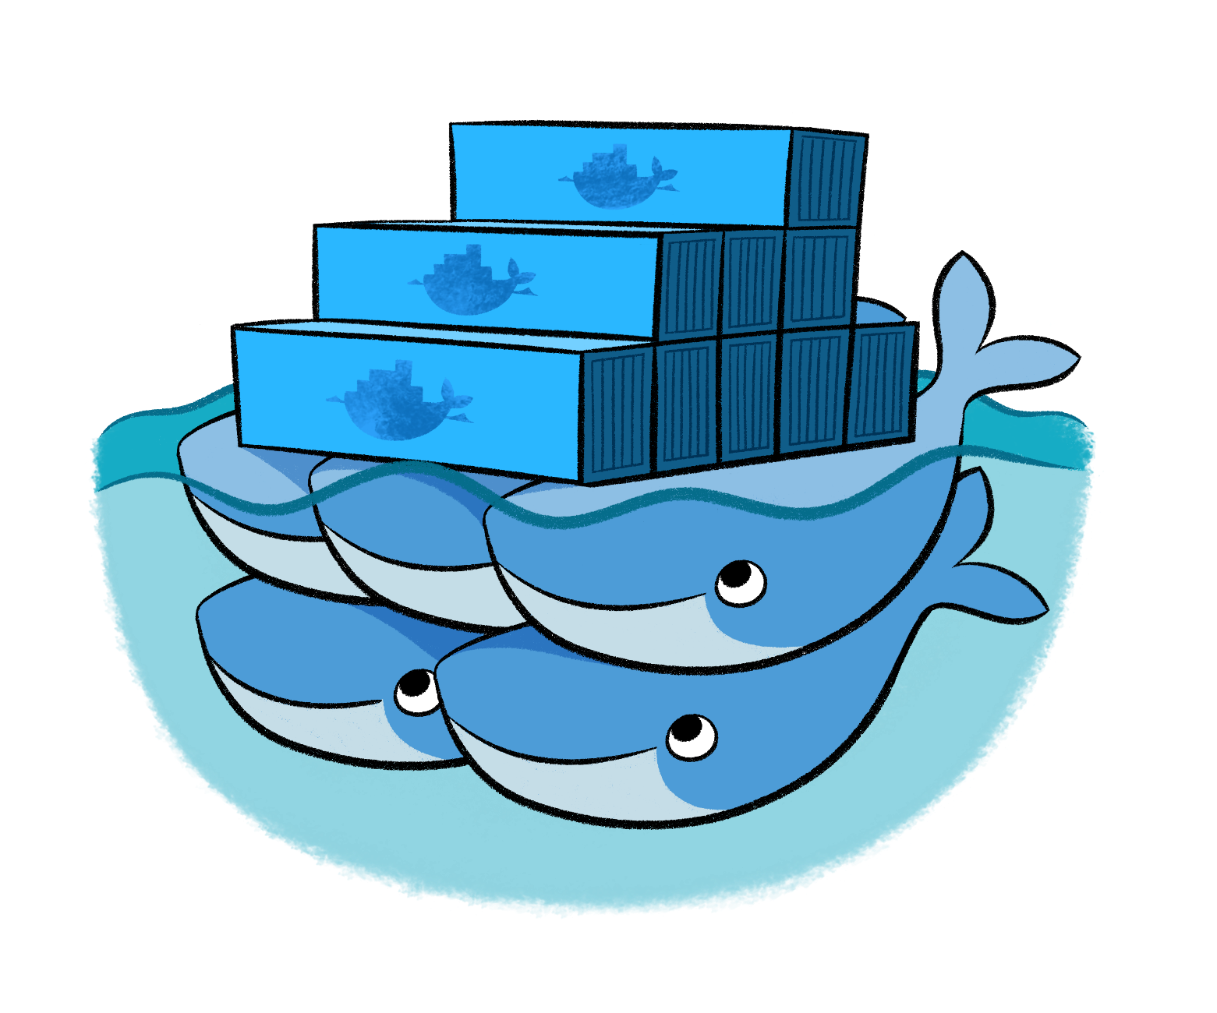
Docker
Leading open-source containerization platform
Supported natively in Azure
Docker containers wrap up a piece of software in a complete filesystem that contains everything it needs to run: code, runtime, system tools, system libraries – anything you can install on a server. This guarantees that it will always run the same, regardless of the environment it is running in
Notes:
Docker (www.docker.com) isn't the world's only containerization platform, but it is the most popular. It is free, open-source, and Linux-based, with Windows support (Windows Server 2016) in the works. It has earned massive mindshare in the developer community. And with Azure Container Service, you can deploy Docker containers to Azure with minimal effort. Moreover, Docker containers are easily moved between Azure and Amazon Web Services (AWS), affording developers portability between cloud platforms.

Slide 8
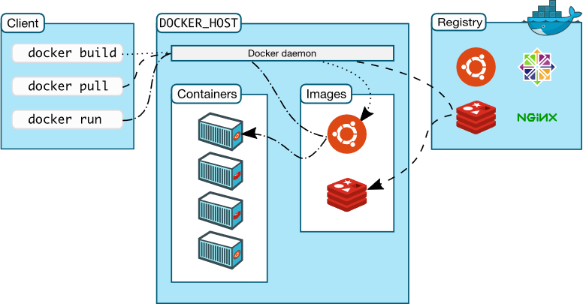
Docker Architecture
Notes:
Docker utilizes a client-server architecture. You execute Docker commands through a Docker client such as the Docker CLI or Kitematic. The client uses REST commands to communicate with the Docker daemon running on a Docker host such as the Azure Container services. These commands can be used to push, pull (docker pull), and create Docker images, to run them in containers, and to manage those containers. Images can be built with the docker build command, and they can be stand-alone, or they can "inherit" from other images. Images are stored in Docker registries, which can be public or private, local or remote. Docker Hub is a popular public registry that is managed by Docker; it contains a "huge collection" of images that anyone may use. The docker run command runs a container using an image as a template.

Slide 9
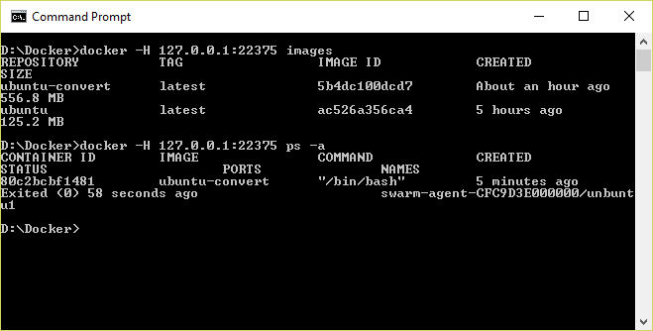
Docker CLI
Command-line interface for Docker, available for Linux, OS X, and Windows (available separately or as part of Docker Toolbox)
Notes:
The Docker Client, also known as the Docker CLI, is the primary tool you use to manage Docker containers. You can download container images from repositories such as Docker Hub, build container images, run container instances, list container images and instances, and much more. After connecting to Azure Container Service using SSH, you can use port forwarding to execute commands locally that act on an Azure Container Service running in the cloud. In this example, the -H switch used with the docker commands forwards commands sent to port 22375 on localhost to the Azure Container Services via SSH.

Slide 10
Running a Container
docker run -i -t ubuntu /bin/bash
Docker CLI command
Run container with interactive terminal
Pull "ubuntu" image from Docker Hub or local registry
Command to execute in the container
Notes:
This command pulls the image named "Ubuntu" from Docker Hub (or a local registry if the image is cached there) and runs it interactively in a container. "Interactively" means standard input, output, and error are connected locally so you can provide input to the container and see its output. Of course, you are not limited to the "Ubuntu" image. You can specify other images and even create images of your own with docker build. Where the container runs depends on the context. The container can run locally in a docker host (for example, a VM on Windows), or it can remotely if you connect to a remote Docker daemon (for example, one running in Azure) via SSH tunneling and use port forwarding to forward docker commands to the daemon.

Slide 11
Common Docker CLI Commands
docker run - Use an image to run a container
docker pull - Pull an image from a registry
docker build - Build a Docker image
docker images - List available Docker images
docker ps - List running Docker containers
docker exec - Execute a command in a container
docker stop - Stop a running container
Notes:
These are some of the most commonly used docker commands. You can also use docker push to push an image to a registry such as Docker Hub. Also, docker ps is often accompanied by a -a switch to list all containers, including those that are no longer running, while docker rm and docker rmi are used to delete (remove) containers and images, respectively. The docker build command uses a Dockerfile (a text file containing build commands) and a "context" -- for example, a specified directory in the file system -- to build Docker images.

Slide 12
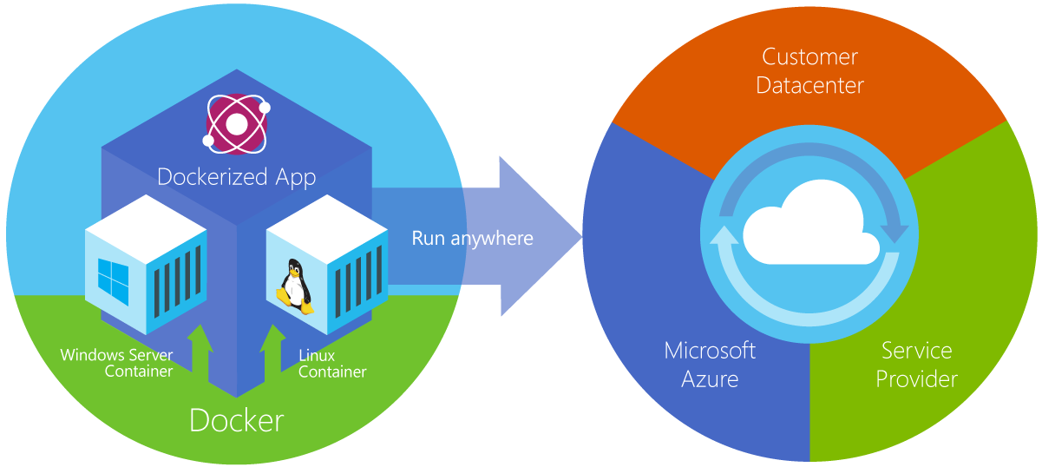
Azure Container Service
Provides robust, ready-to-use Docker hosting environment
Uses open-source orchestration tools (DC/OS and Swarm)
Notes:
From the documentation: "Azure Container Service makes it simpler for you to create, configure, and manage a cluster of virtual machines that are preconfigured to run containerized applications. It uses an optimized configuration of popular open-source scheduling and orchestration tools. This enables you to use your existing skills, or draw upon a large and growing body of community expertise, to deploy and manage container-based applications on Microsoft Azure." ACS supports Linux containers and Windows containers. The latter rely on Windows Server 2016.

Slide 13
Container Orchestration
Facilitates deployment and management of containers
Containers by design are intended to be deployed in large volumes with some applications using dozens to even thousands of containers
With this type of scale, automating container deployment and management with orchestration software becomes necessary
Azure Container service supports Kubernetes, DC/OS, and Docker Swarm
Notes:
Orchestration in the context of containers is the deployment and management of containers across infrastructure and networks. It provides the tools and software defined infrastructure needed to deploy containers. Containers by design are intended to be deployed in large volumes with some applications using dozen to even thousands of containers. With this type of scale, automating deployment and management of containers with Orchestration Software becomes necessary.

Slide 14
Container Clusters
Facilitate load balancing, scalability, and high availability
A cluster is composed of master nodes which control the orchestration, and agent nodes that host the containers
Notes:
A container cluster is intended to have redundancy for load balancing, scalability, and high availability. A cluster is composed of one or more Master Nodes which control the orchestration for scaling and delegation of tasks to the agents as well as provide monitoring. The Agent Nodes actually run the container loads.

Slide 15

Kubernetes
Open-source orchestration engine from Google
Provides a robust framework for container orchestration, yet remains lightweight and scalable
Supported by Azure Container Service and tightly integrated with ACS, allowing Kubernetes to modify deployments
Notes:
Kubernetes is an open-source platform for automating deployment, scaling, and operations of application containers across clusters of hosts, providing container-centric infrastructure.
With Kubernetes, you are able to quickly and efficiently respond to customer demand:
Deploy your applications quickly and predictably.
Scale your applications on the fly.
Seamlessly roll out new features.
Optimize use of your hardware by using only the resources you need.

Slide 16
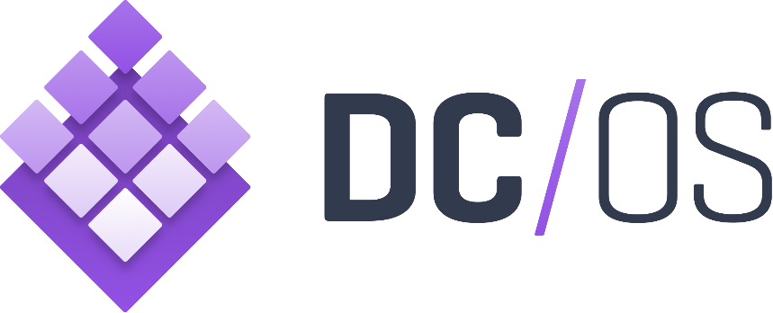
DC/OS
Datacenter Operating System built on Apache Mesos
Creates logical data centers and abstracts underlying hardware
Provides resources traditionally provided by infrastructure, including networking, DNS, and load balancing
Natively supported by Azure Container Service
Notes:
Datacenter Operating System is, as the name implies, an operating system for a datacenter rather than for a phyiscal of virtual machine. DC/OS abstracts away the underlying hardware from applications and provides much of the needed infrastructure that would otherwise come from multiple disparate services on traditional networks. This enables operations and developers alike to deploy and maintain applications in a uniform fashion with less time and resources spent monitoring the supporting network and network services for those applications.

Slide 17
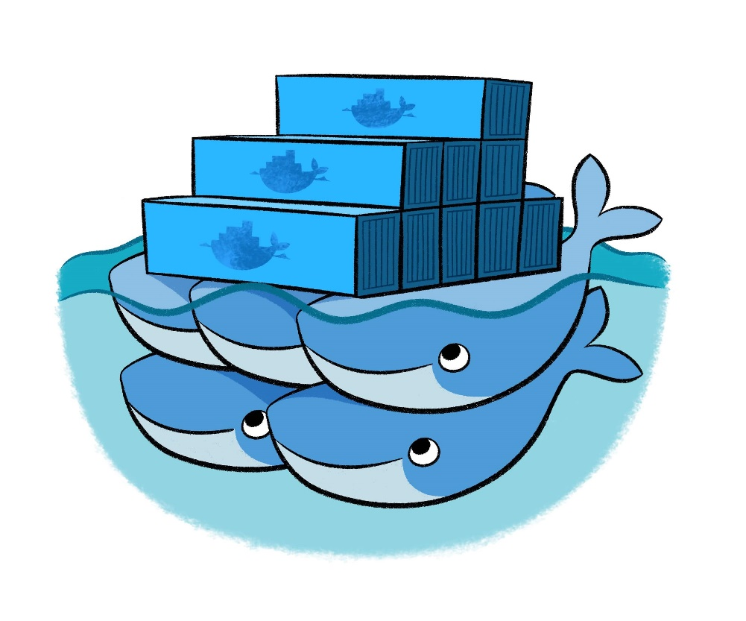
Docker Swarm
Docker’s own orchestration engine
Current releases of the Docker engine have “Swarm Mode” built in and can many of the same things that other orchestration engines do
Lacks a GUI, but makes up for it with tight integration with Docker
Natively supported by Azure Container Service
Notes:
Docker Swarm is the orchestration engine from Docker. It has tight integration with Docker, so many of the same paradigms and tools that used with Swarm seamlessly as well as some additional features like overlay networks and Docker services that can run multiple containers spread across multiple hosts. These containers can seamlessly communicate and rapidly scale.

Slide 18
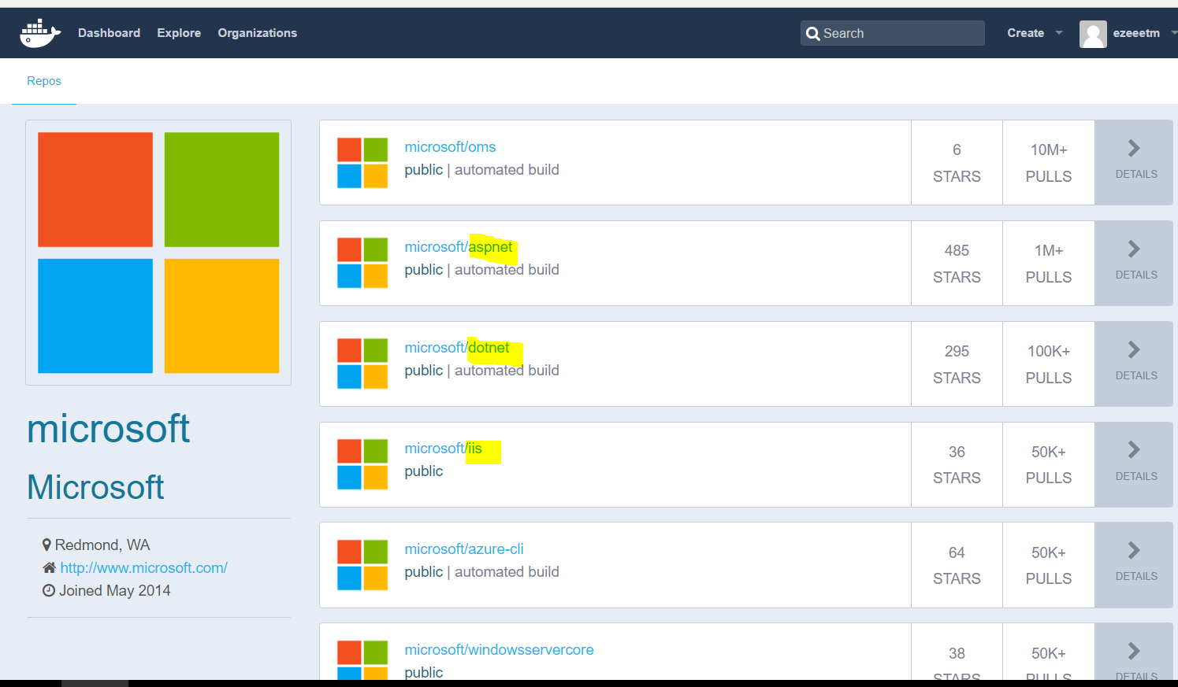
Docker Hub

Slide 19
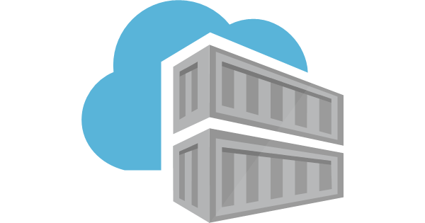
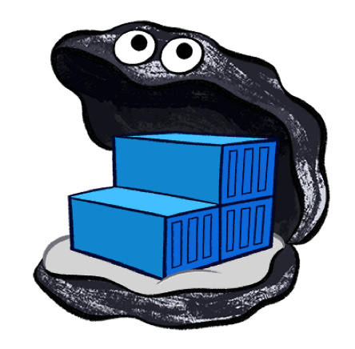
Other Registries
Azure Container Registry
Docker Trusted Registry

Slide 20

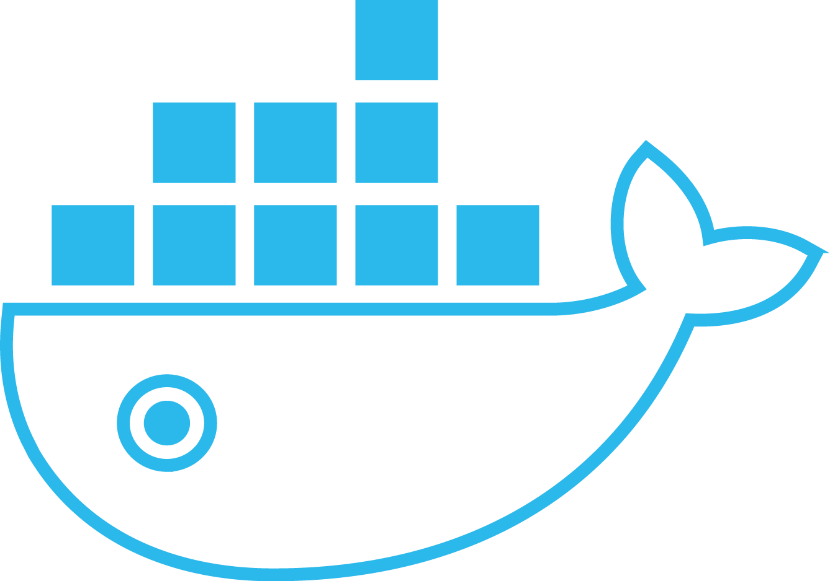
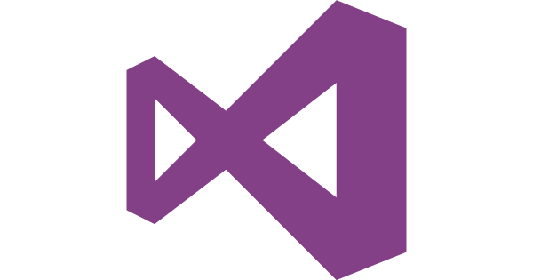

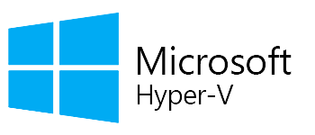
Docker Enterprise on Azure
Docker Interfaces
Docker Datacenter
Partner Integrations
Client
Docker Trusted Registry
Docker Universal Control Plane
Network
Plug-ins
Volume
Plug-ins
Compose
Monitoring
Logging
Content Security
Docker for Windows
LDAP/ AD
Storage Drivers
Docker Swarm
Plug-in for Visual Studio & VS Code
Any Application
Commercially supported Docker Engines
Windows Server 2016
Linux
Anywhere

